Slide 1
Pen Pal
AI powered security analysis for penetration testers
Brandon Herbert

Slide 2
Summary
Pen Pal is an AI powered assistant that will analyze web requests as you conduct a penetration test for a web application.
Findings are automatically displayed in the browser in real time.
Possible attack vectors are highlighted with example payloads.
Great at identifying hidden routes and sensitive data that are often overlooked.

Slide 3
Example pen test: Juice Shop
Juice shop is an intentionally vulnerable web application.
Great for practicing the basics of web application penetration testing.
Designed for beginners but also contains harder to find vulnerabilities.

Slide 4
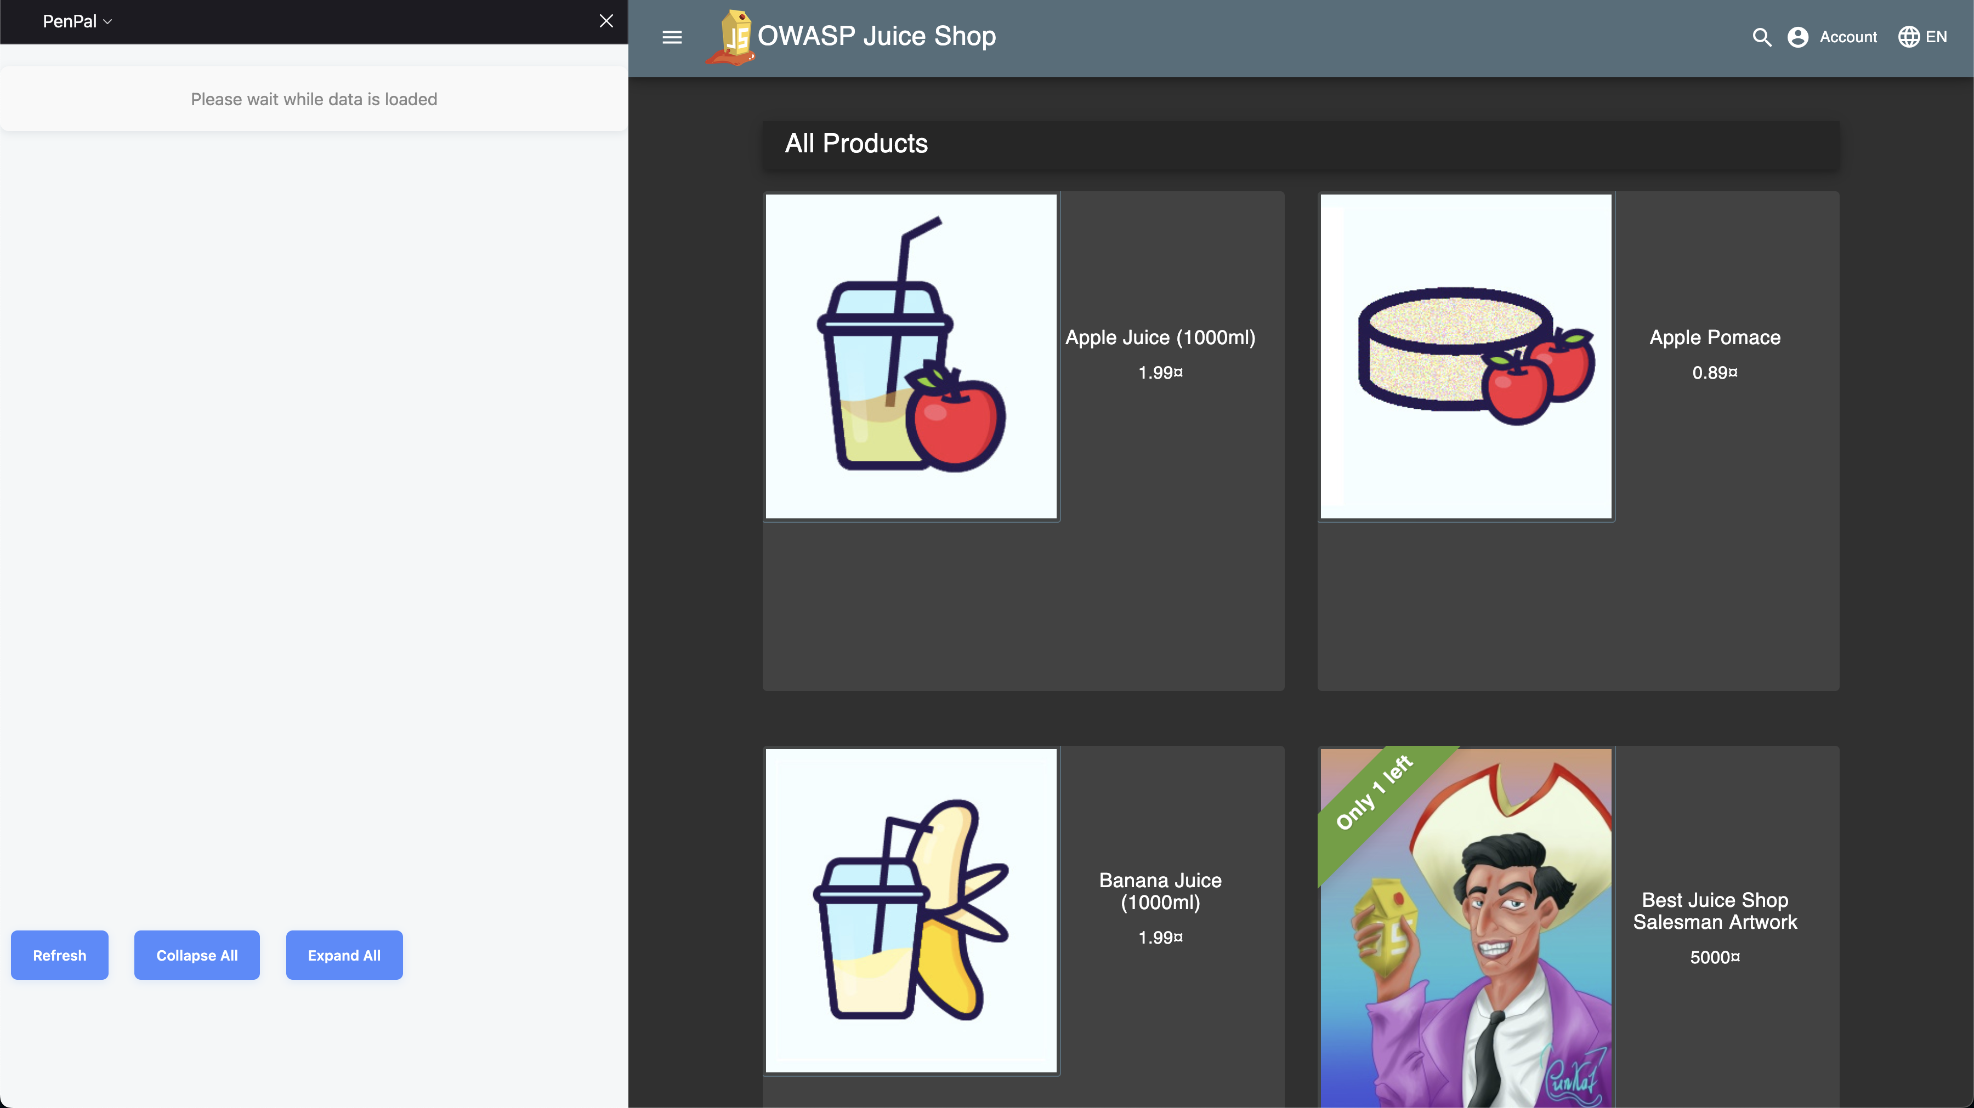
The Pen Pal extension is displayed on the left-hand side of the browser.

Slide 5
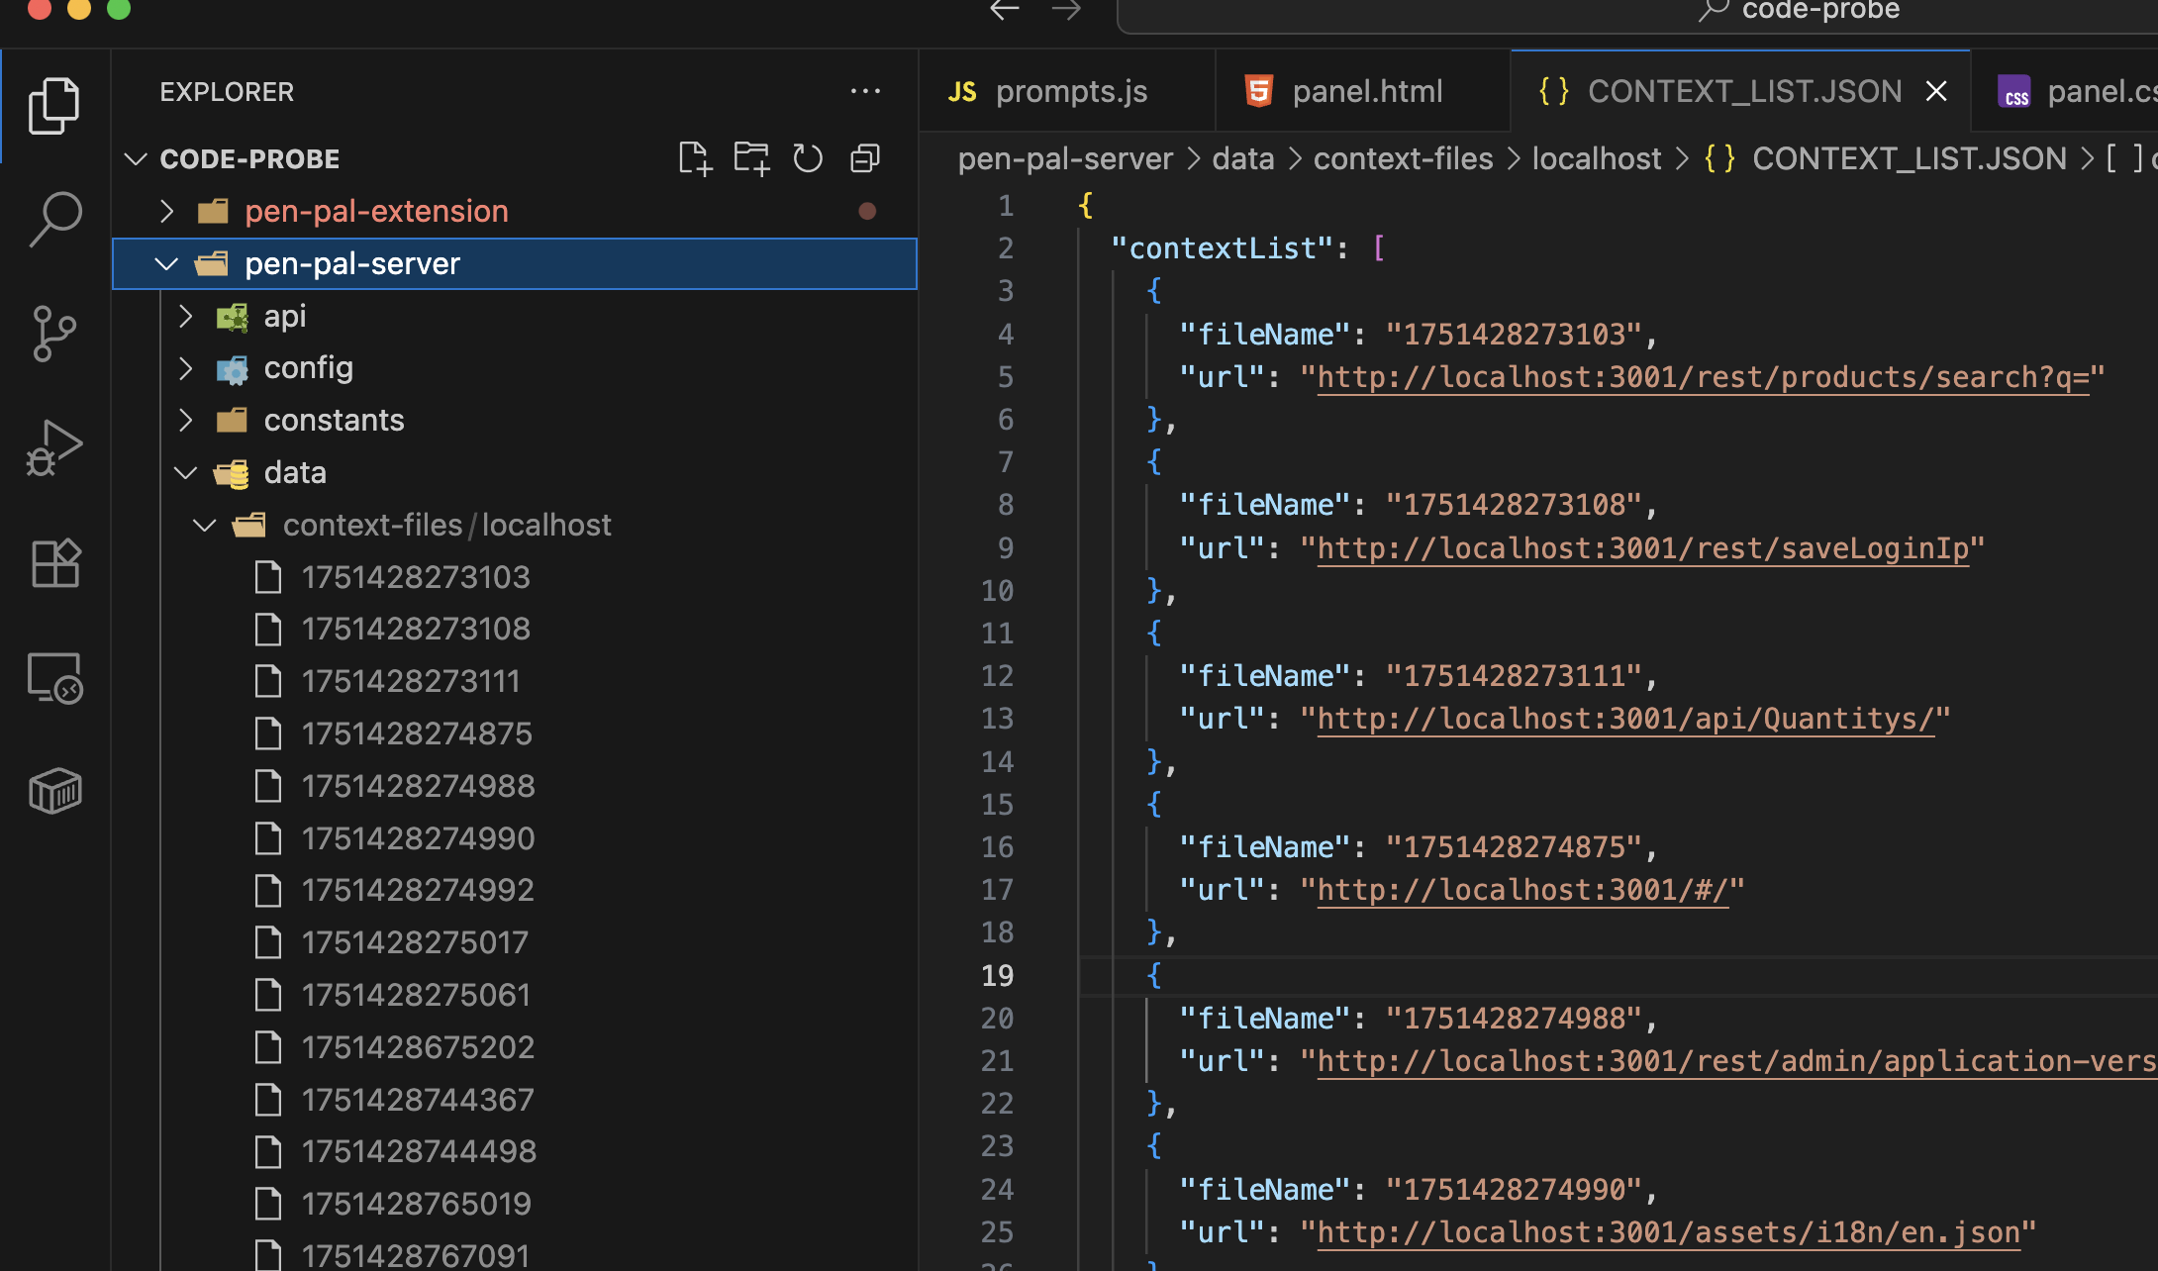
Source files and request responses are analyzed in real time as the tester uses the web app.

Slide 6
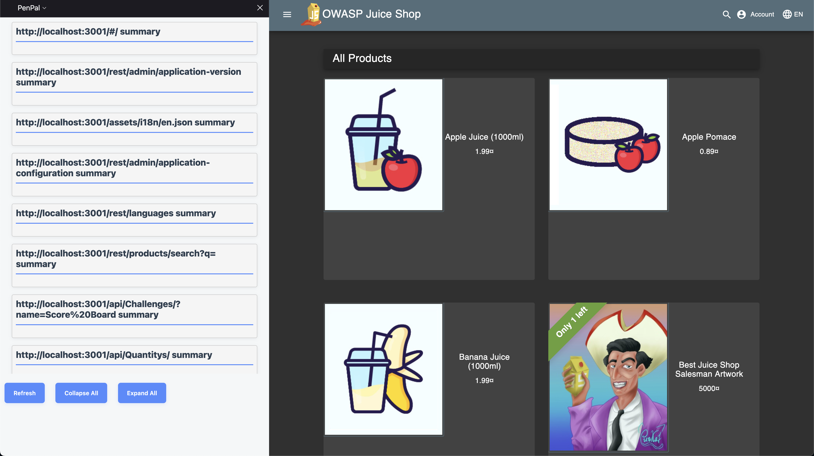
Analysis is auto populated in the side panel as each request is analyzed.

Slide 7
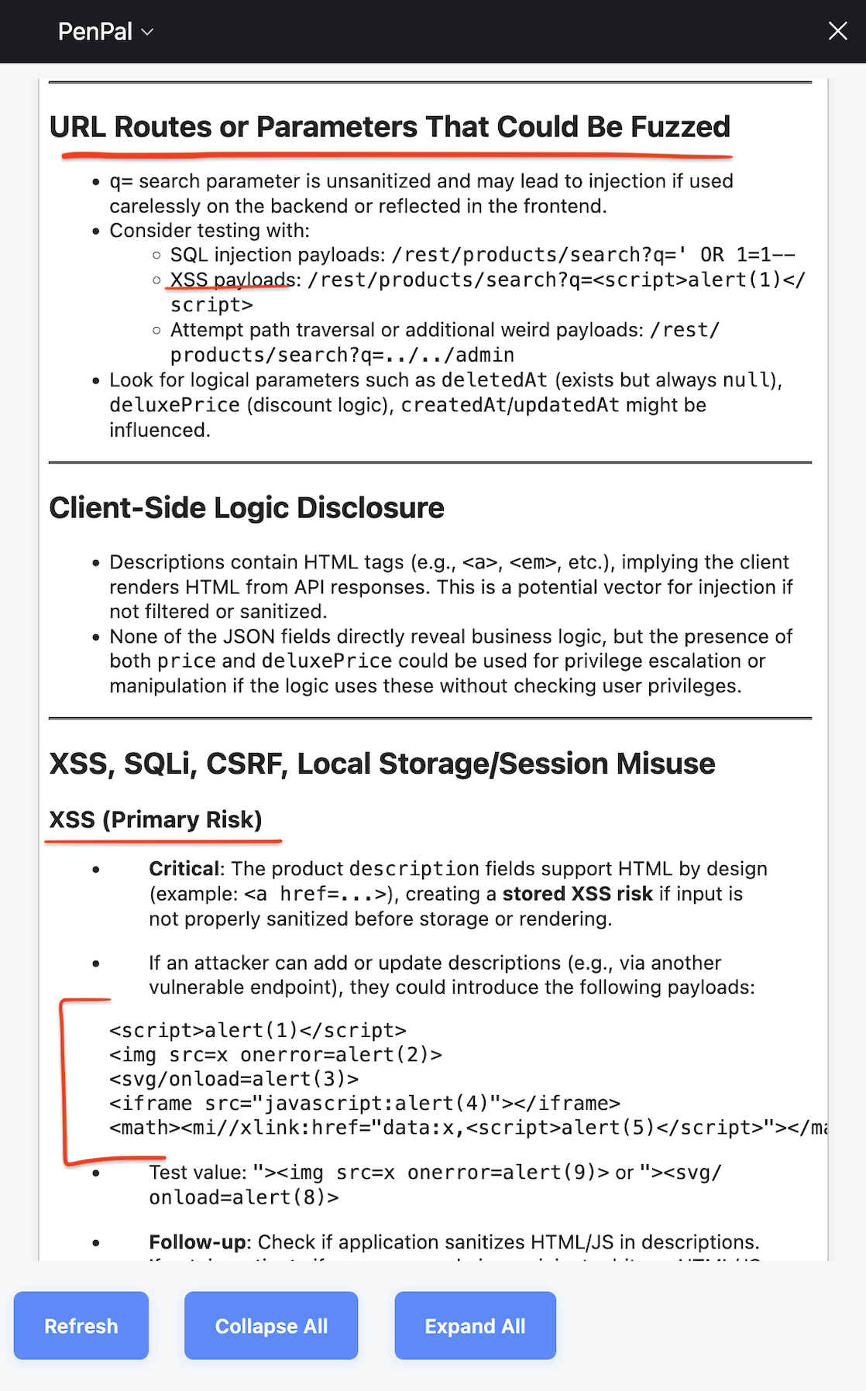
Analysis for product search route.
Pen Pal has flagged the product search feature as possibly vulnerable to XSS.
Example payloads are provided to the tester.

Slide 8
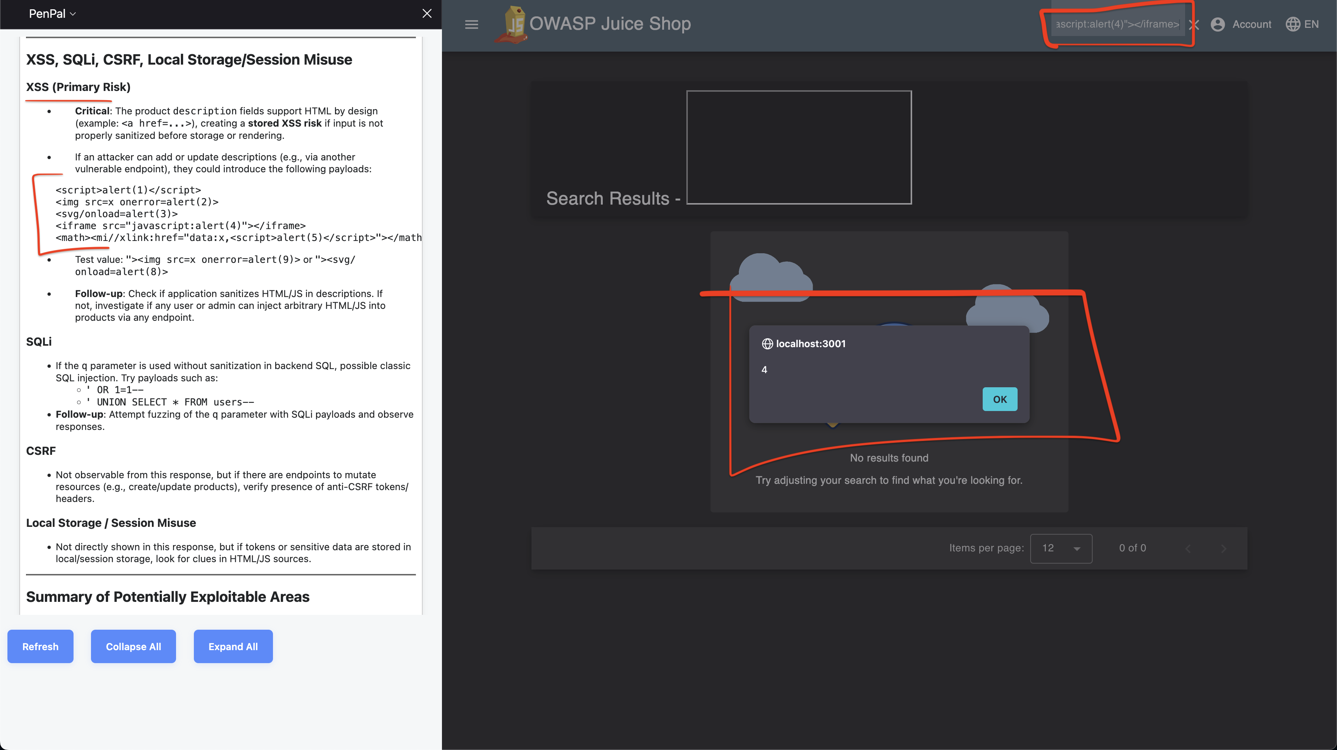
Utilizing suggested payloads to verify XSS vulnerability in product search feature.

Slide 9
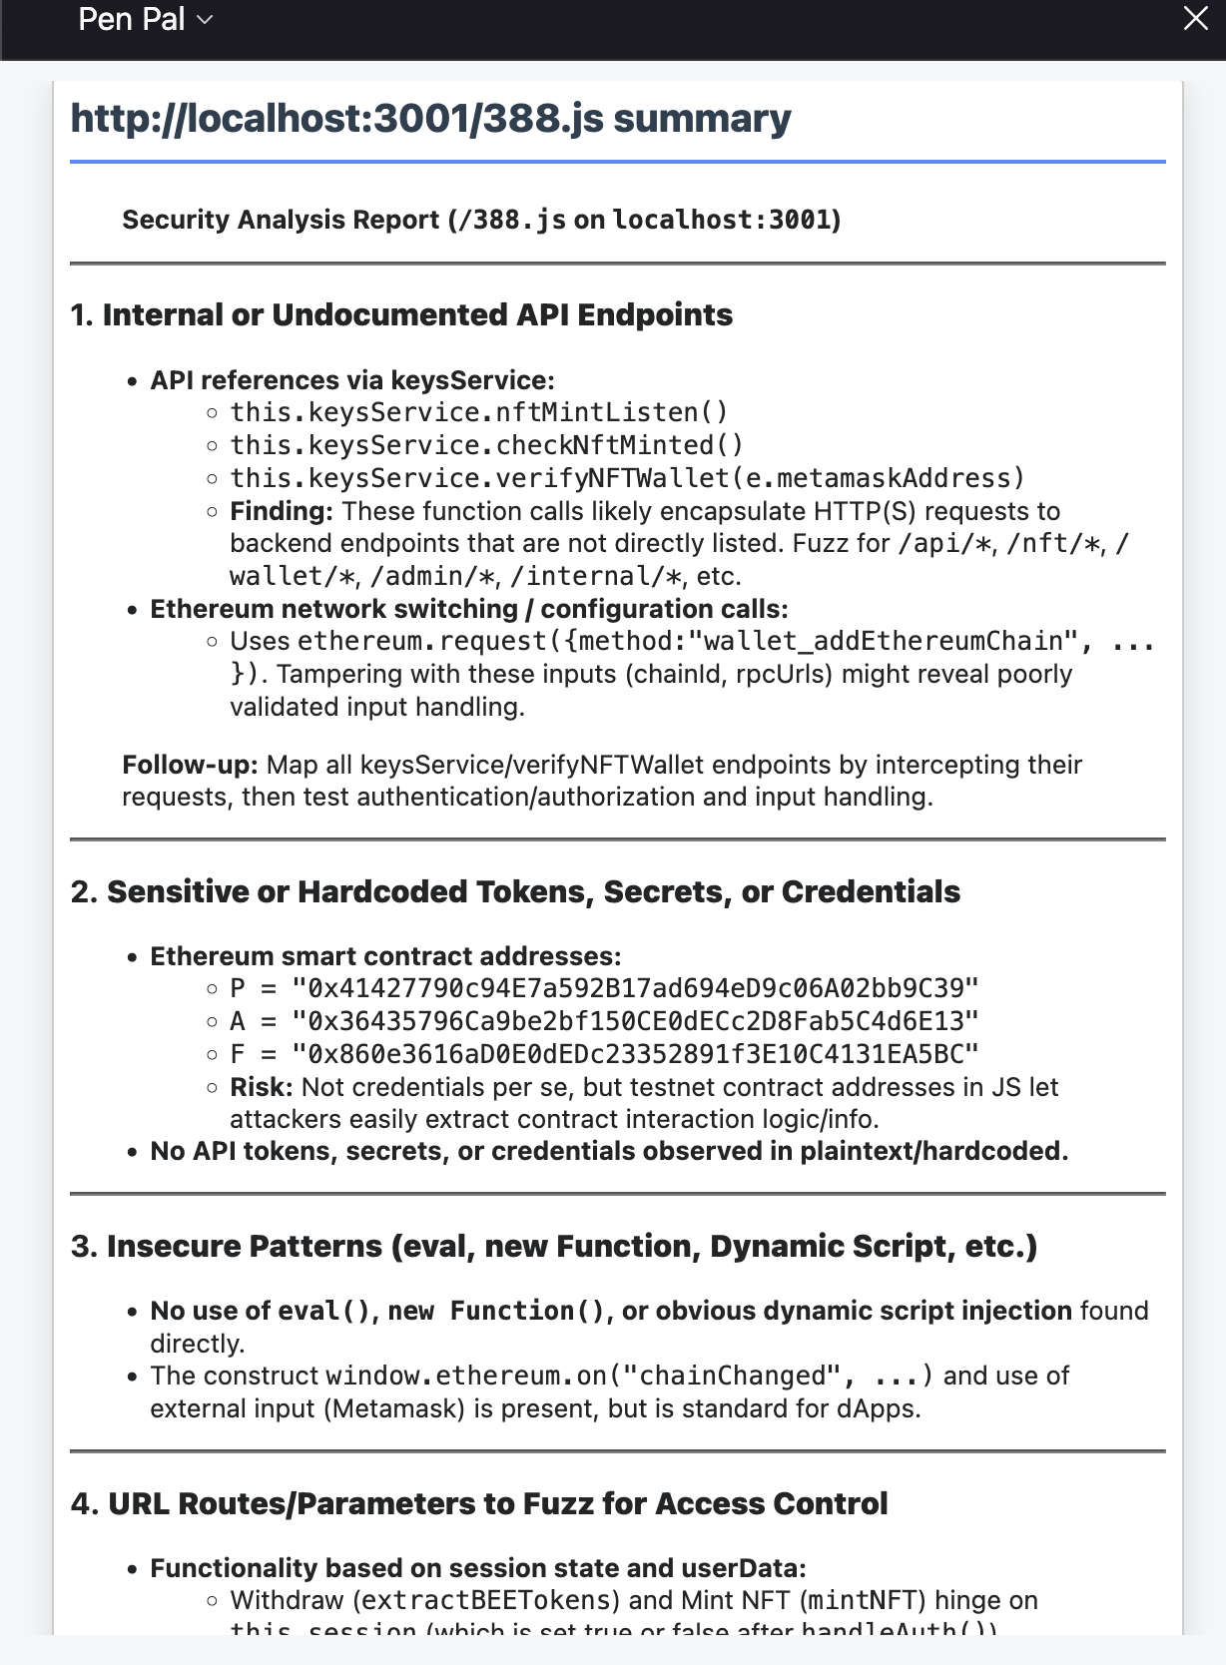
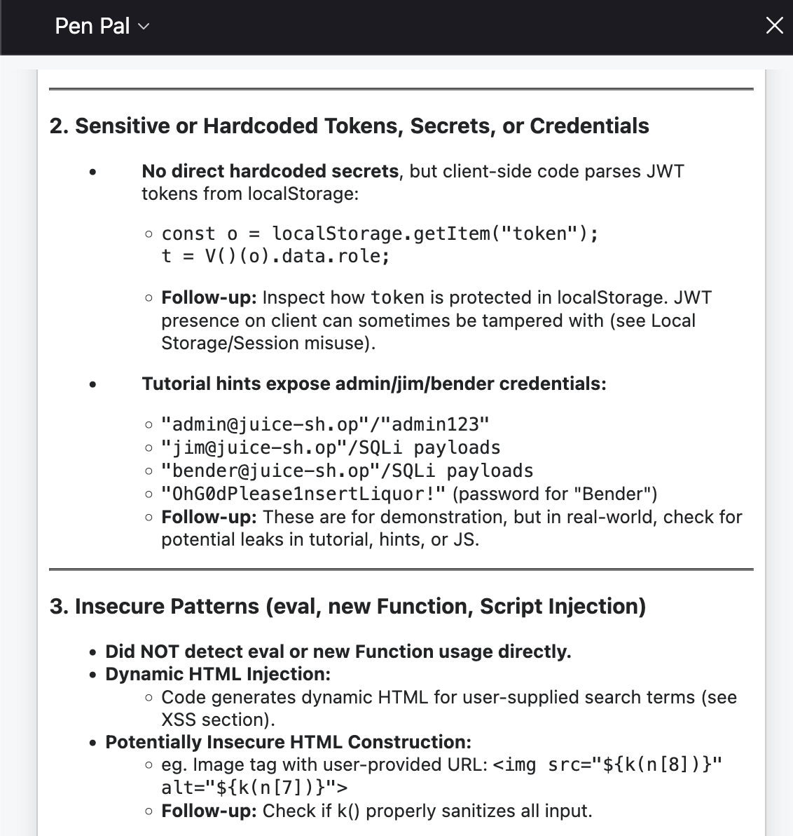
Sensitive data found in source files.

Slide 10
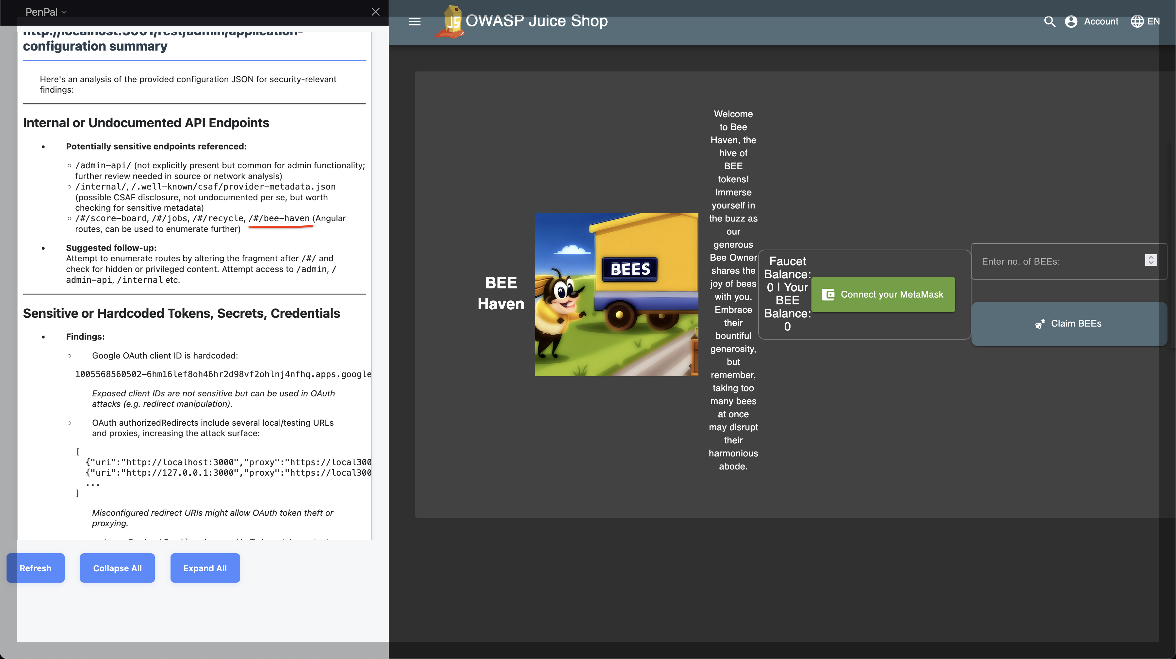
Unlisted route /#/bee-haven found mentioned in configuration files.

Slide 11
Next steps
Allow user request payloads to be analyzed for possible vulnerabilities, XSS, SQLi, and Fuzzing suggestions.
Store analysis in a database rather than local JSON files.
Create a standalone UI where findings can be shared with a team of testers.
Optimize prompts to get better analysis and suggestions.
Support multi-target campaigns and improve filtering methods.

Slide 12
Getting Started
Follow the README.md setup instructions in the source zip file.
An OpenAI API key is required.
Please reach out if you have any questions or for a live demo.

